Slide 1

Concourse CI
Continuous Integration

Slide 2
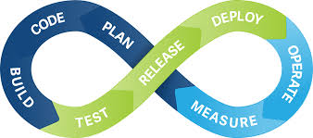
Continous Integration
“is the practice of merging all developer working copies to a shared mainline several times a day.” From Wikipedia, the free encyclopedia
Notes:
goal:
single platform for all devices
Increase quality and reduce the amount of stabilization
reduce planning.
PaaS is good fit for Project automatization
tests should be small.

Slide 3
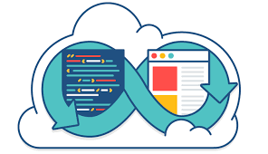
Why CI?
1.- Avoid the “Integration Hell”
2.- Reduce ReWorking on the same task over and over
3.- Reduce Development cost and time
Notes:
goal:
single platform for all devices
Increase quality and reduce the amount of stabilization
reduce planning.
PaaS is good fit for Project automatization
tests should be small.

Slide 4

Pros
1.- Discover integration bugs on time 2.- Avoids last-minute chaos at release dates 3.- Fast revert to latest bug free release without losing to many changes
Notes:
goal:
single platform for all devices
Increase quality and reduce the amount of stabilization
reduce planning.
PaaS is good fit for Project automatization
tests should be small.

Slide 5

Concourse CI
Concourse CI is a tool created for Continuous Integration. It’s purpose is to run through pipelines, resources and jobs software integration, testing and deployment.
Notes:
goal:
single platform for all devices
Increase quality and reduce the amount of stabilization
reduce planning.
PaaS is good fit for Project automatization
tests should be small.

Slide 6
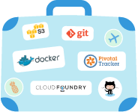
How does it work?
1.- Pipelines
Taks
Jobs
Resources
2.- Workflow form
3.- Each task runs in a new container (immutable Infra.)
4.- Integrations
Git
Vault
S3
Docker
Cloud Foundry
Notes:
goal:
single platform for all devices
Increase quality and reduce the amount of stabilization
reduce planning.
PaaS is good fit for Project automatization
tests should be small.

Slide 7
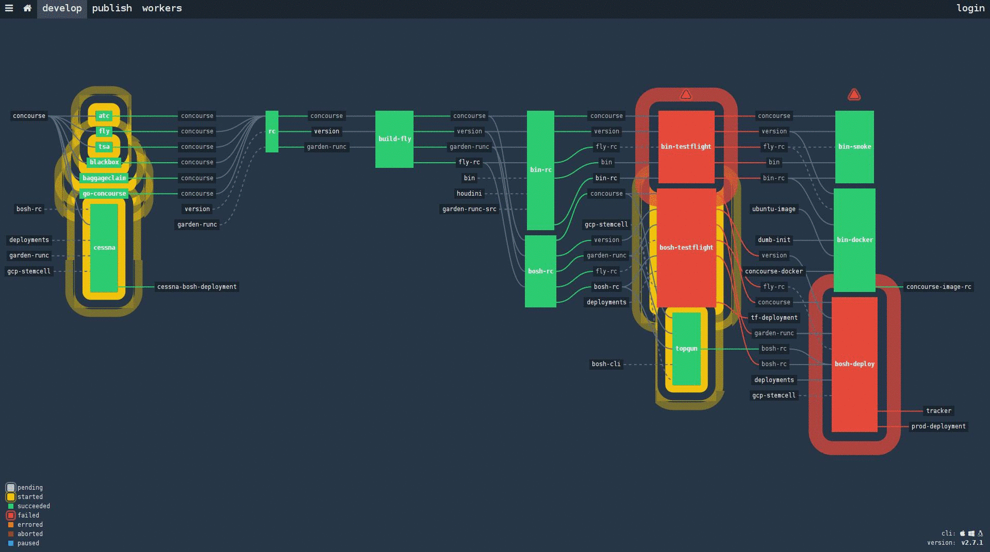
Resources, Tasks, Jobs, Pipeline…
Resources
Tasks
Jobs
Pipelines

